Slide 1
ClimateCompass
95-835 Time Series Forecasting, Fall ‘23
Project Team: Nitin Chandola, Nithin Manjooran, Chad Merrill, Sahil Somani, Praneet S Y
Notes:
Hello everyone! My name is Nitin Chandola and I will be presenting a Shark Tank idea called Climate Compass!

Slide 2
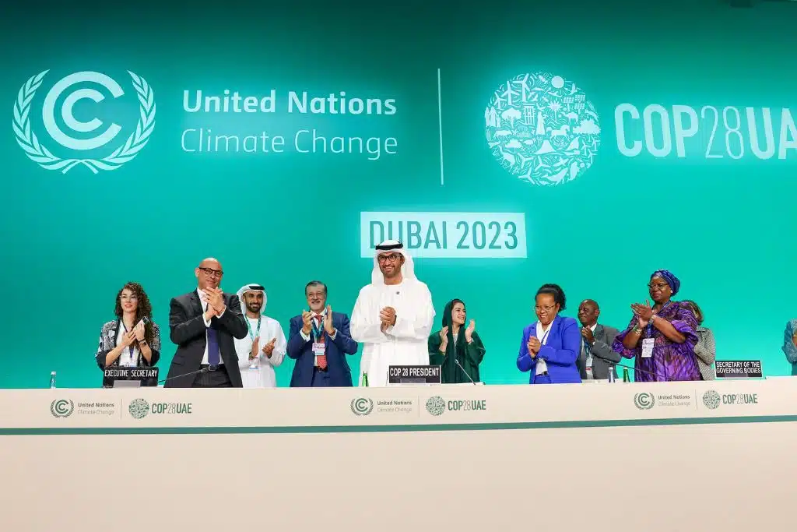
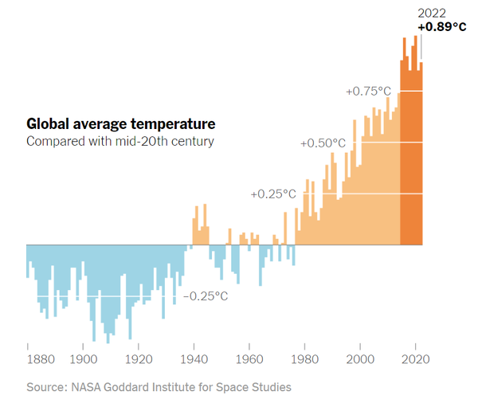
Motivation
Global warming is changing the world
Global average temperature is rising
Notes:
Global warming is very REAL! The interest on the topic is growing every year AND if there was ever a time to invest in this space, it is NOW.
As we talk, country leaders from around the globe are meeting in Dubai to discuss climate changes in the COP28 conference.
Also, as you can see on the slide - a chart shared by NASA shows that the global average temperature has been continuously rising and is already close to 1 degree Celsius higher from the 1950s.
Incidentally, the observed air temperature in the UAE rose by 1.27° Celcius between 1990 to 2022.

Slide 3

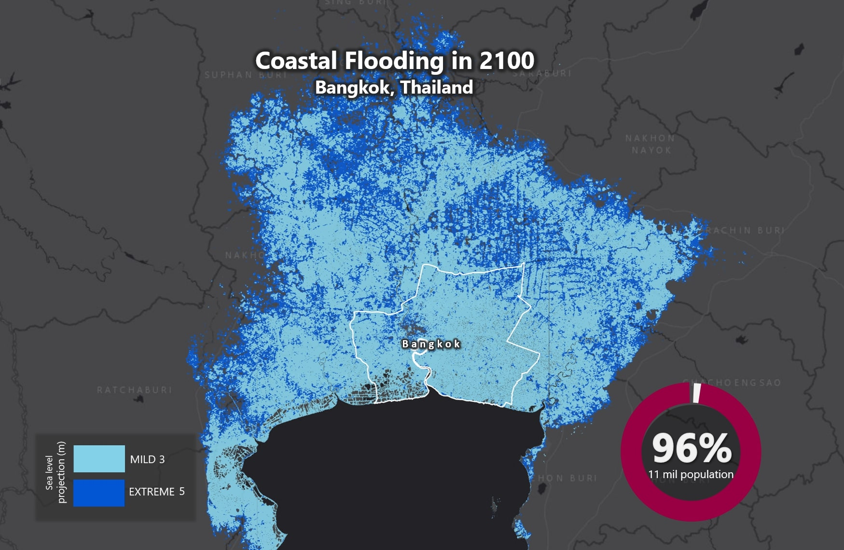
Case of Rising Sea Levels - Bangkok, Thailand
Bangkok: 2011 - 20% of city underwater. 100s dead.
[source: Earth.org]
Sea Level Rise Projections by 2100 - 3m to 5m.
[source: Earth.Org]
Notes:
Here’s another deadly example - Following the floods of 2011, a fifth of Bangkok was reportedly underwater and hundreds of people lost their lives.
Bangkok has an average elevation of 1.5 metres above sea level.
Earth.org estimates a 3 to 5 meters of rise in sea level by 2100. The screenshot on the right hand side of the slide shows the Bangkok and surrounding area estimated to be underwater. An estimated 96% of population will be displaced; thats 11 million people in this region alone.

Slide 4
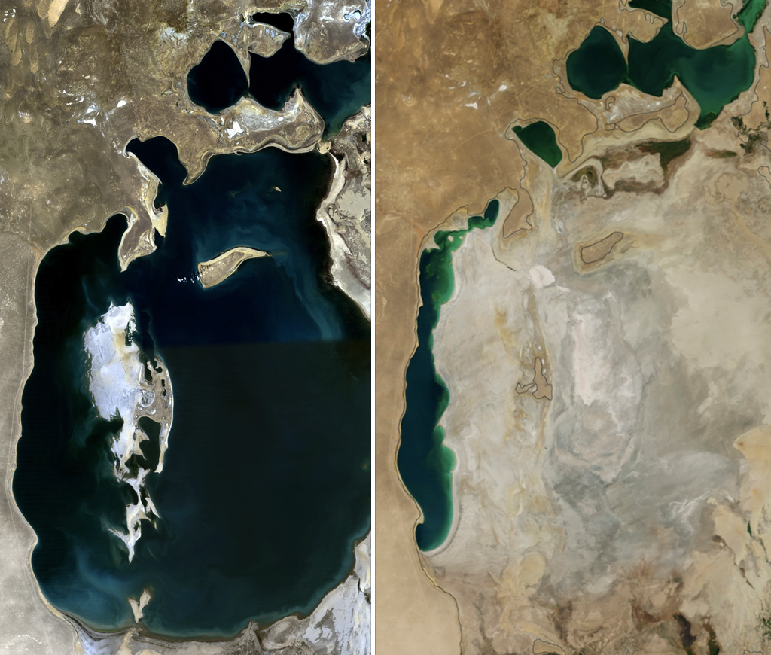
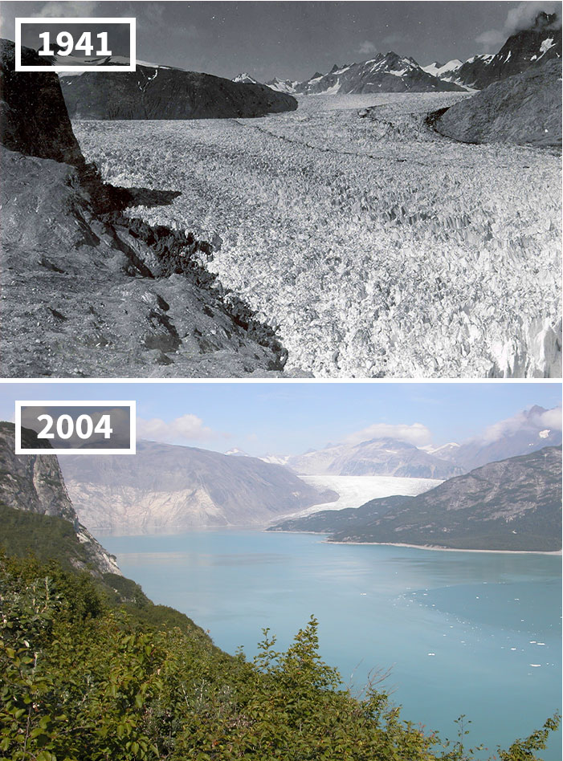
Disappearing Lakes and Melting Glaciers
Aral Sea, Central Asia
Muir Glacier, Alaska
1989
2014
Notes:
Similarly, Global warming will lead to disappearing lakes and melting glaciers.
Lakes and glaciers play a significant role in maintaining the survival and development of human habitations and the stability of the surrounding ecology.

Slide 5
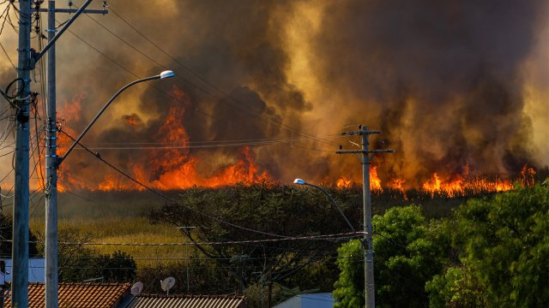
User Group 1: Individuals
Weather affects housing choice
Drivers: Retirement, Job Relocation, Safety, Lifestyle
Primary Concern: Long-term quality of life
Notes:
Our market research confirms that the global warming threat is real and it’s affecting many aspects of people’s lives, businesses and governments at all levels. These user groups are interested in learning about future weather characteristics and what all this means for them.
Just a few years, forest fires engulfed areas previously untouched for decades or centuries, such as the Big Basin near San Francisco. The sky turned red for almost two months, major highways were closed, homes were burnt down impacting lives, and businesses in many ways.
We know now that individuals are interested in learning about the temperature forecast for their current city of residence, or cities they are considering for relocation. People want to know the forecast to understand how the rising temperature impacts their lifestyle, cost & quality of living, power consumption needs, safety issues and risks like wildfires, and changing property value over time.

Slide 6
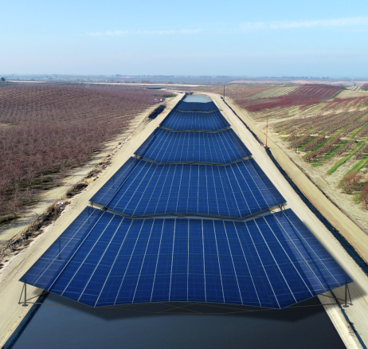
User Group 2: Governments & Companies
Weather affects demography and business
Factors: residents quality of life, risk & safety, cost of doing business
Primary Concern: Future revenue and profit
Notes:
Similarly, business and governments are interested in learning about how climate changes will affect their interests, such as impact on revenue and profits.
Local governments are interested in learning about the risk to their cities and to plan for future power demand for cooling needs. Others are interested in advertising the benefits of living in their city.
Businesses are interested in learning about the cost of doing business in a city, insurance costs, etc.
The use cases are plenty, in our opinion, but we will start with a small set of use cases in our MVP. We will share a short-term and longer term roadmap later in our presentation.

Slide 7
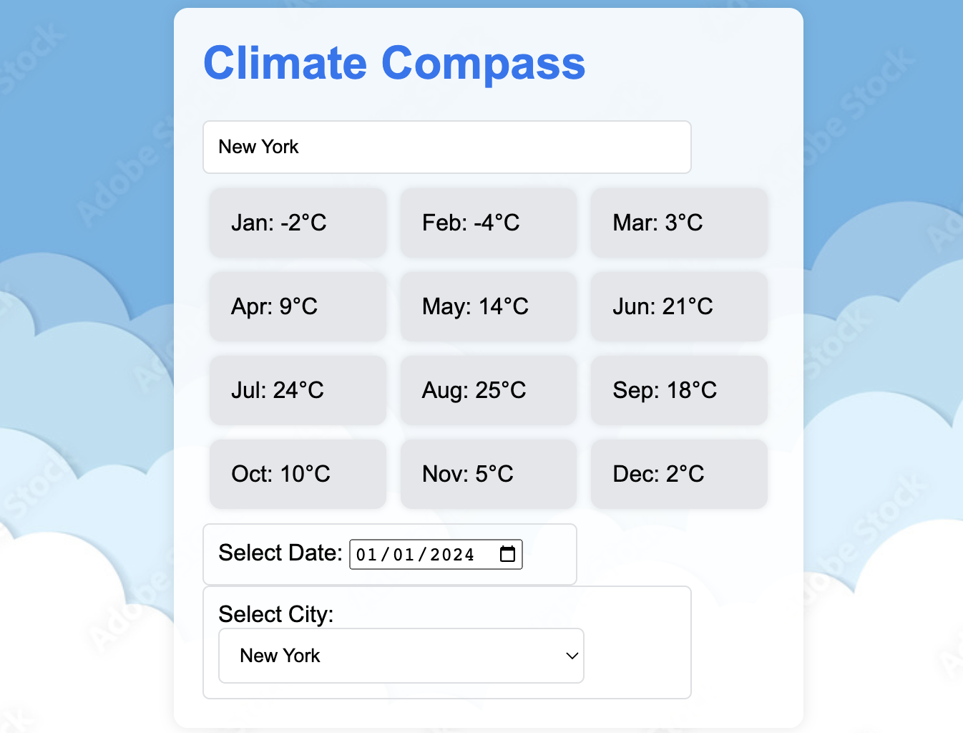
Our Solution
An online platform with long-term climate forecasts for cities globally
Powered by Time Series models
Historical data (1750 to present): from non-profit Berkeley Earth
MVP Technical Stack: Flask, Python, PostgreSQL, ReactJS
Notes:
For our solution, we envision an online platform that is easily accessible through a browser. It will provide the users long-term climate forecasts for cities globally.
In our MVP, we will provide temperature forecasts only. In later releases, we will expand to other weather characteristics.
Our solution is powered by time series models, using historical data from Berkeley Earth. In the future, we will consider augmenting this data set from other sources.
For those curious, our technical stack includes Python as our language of choice, and Flask, PostGres, and the ReactJS framework.

Slide 8
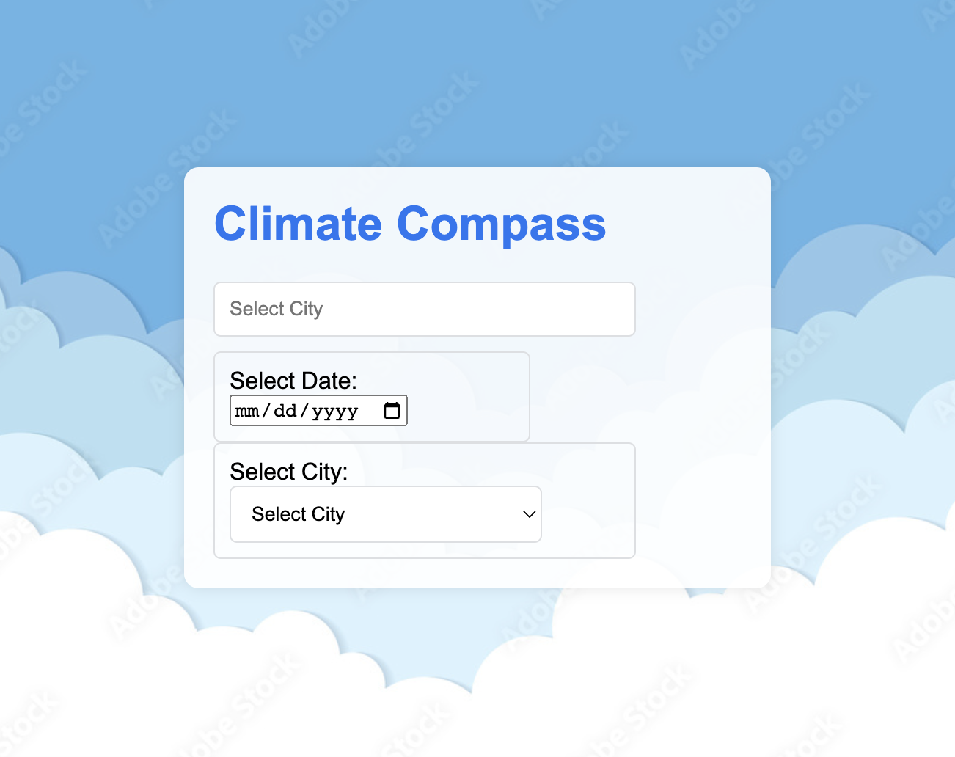
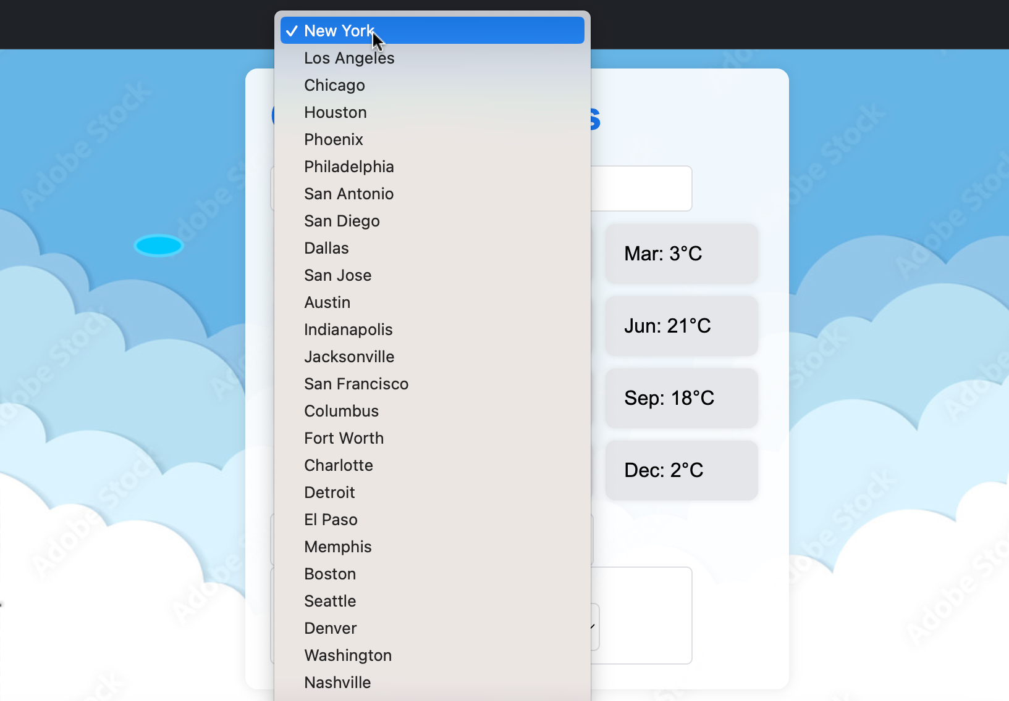
Easy to use - User Interface
Climate Compass Home Page
Step 1: Select a City
Notes:
Let’s take a quick peek into the user journey.
Please note that the User Interfaces shown here are just a sample - it provides the core workflow of the application, and will vary for different user groups. It is by no means, exhaustive. For example, we do not talk about user login, registration, payment setup, etc.
The basic workflow for a business user includes a simple, easy-to-follow landing page. The first step includes selecting a city of interest.

Slide 9
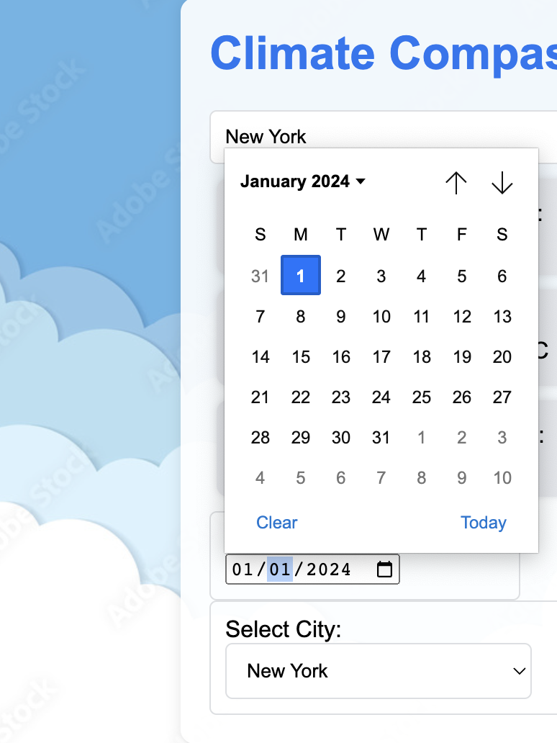
Easy to use - User Interface
Step 2: Select Date from calendar
City Weather Forecast Report (for 1 Year)
Notes:
As a second step, the user will select a date in the future.
The resulting city weather forecast report will display the average monthly temperature forecast for 12 months from the selected Date.
Note that these forecasts are pre-generated on a monthly basis. The system uses multiple time series models for forecasting and automatically picks the best model for each city based on error metrics. This also means that the response time to show the city weather forecast report is fast; our SLA is a p99% of 3 seconds.
In post MVP release, we will include more granular forecast and extend to more weather characteristics.

Slide 10
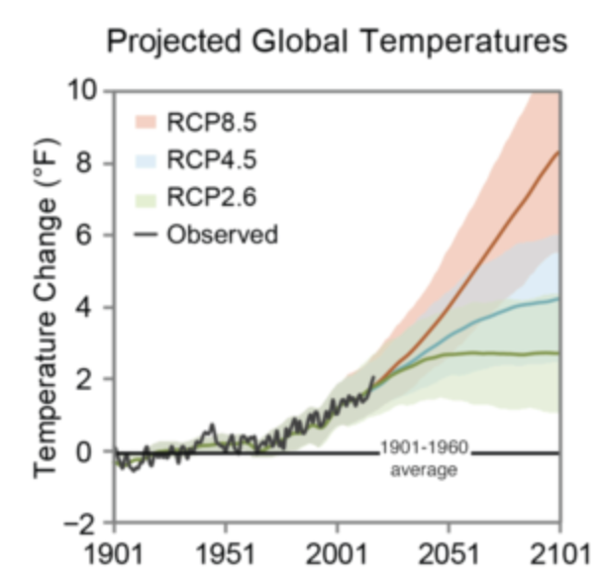
Competition
Suboptimal User Experience
Other services aren’t approachable
E.g., climate.gov
Consumer websites limit their results
E.g., architecturaldigest.com
Notes:
Our strategy to stay ahead of our competition is to take an agile approach. We will keep constant vigil on our competition and the changing market landscape and adjust our plans accordingly.
Currently, there are sites that present the same weather data but its confusing, outdated, and hard for the common person to grasp. Other sites offer reports for limited cities only.
Our solution’s primary distinction is the user experience and journey. The ClimateCompass solution will provide our consumers a great user experience.
ClimateCompass will be easily accessible. It will answer weather forecast questions, that’s on our users mind, in a format that is easy to comprehend.

Slide 11
Forecasting Results

Slide 12
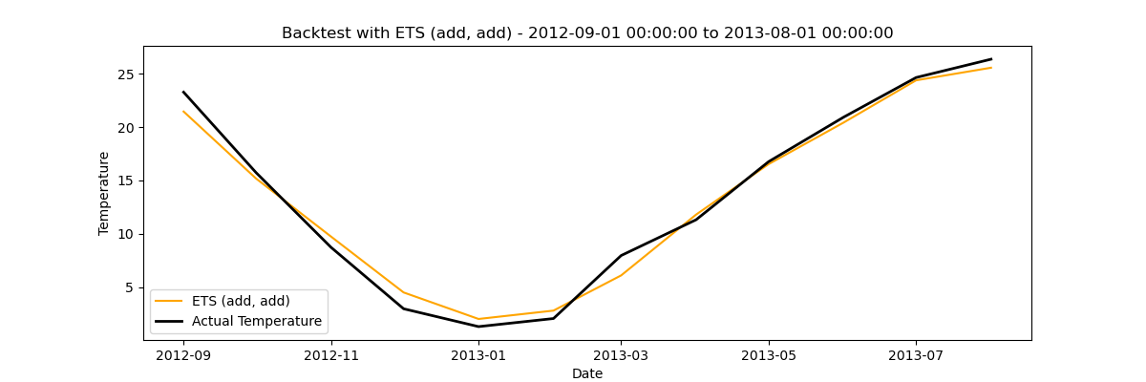
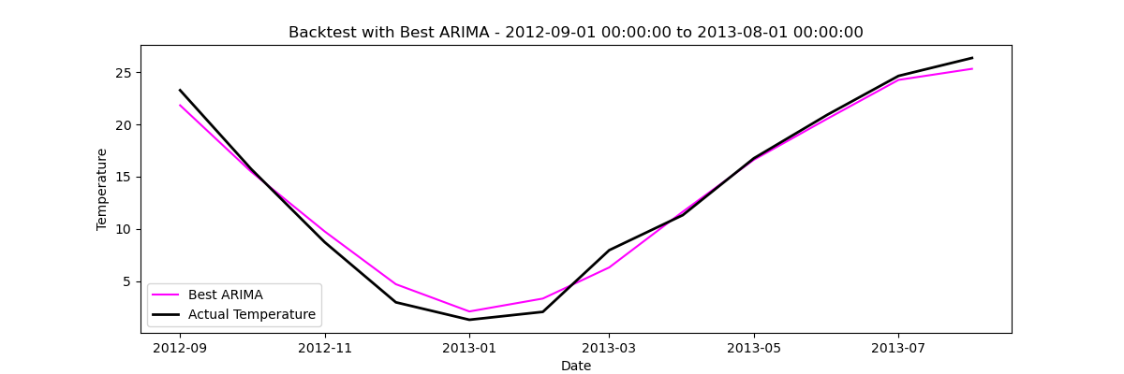
Backtesting Example - 1 Year, Tokyo
Exponential Smoothing
ARIMA
Notes:
Our solutions backtesting results are very promising.
In our example city here, namely Tokyo, you can see forecasting results for 1 year using two time series - Exponential Smoothing, and ARIMA. Notice that our temperature Forecasts are very close to the Actuals.

Slide 13
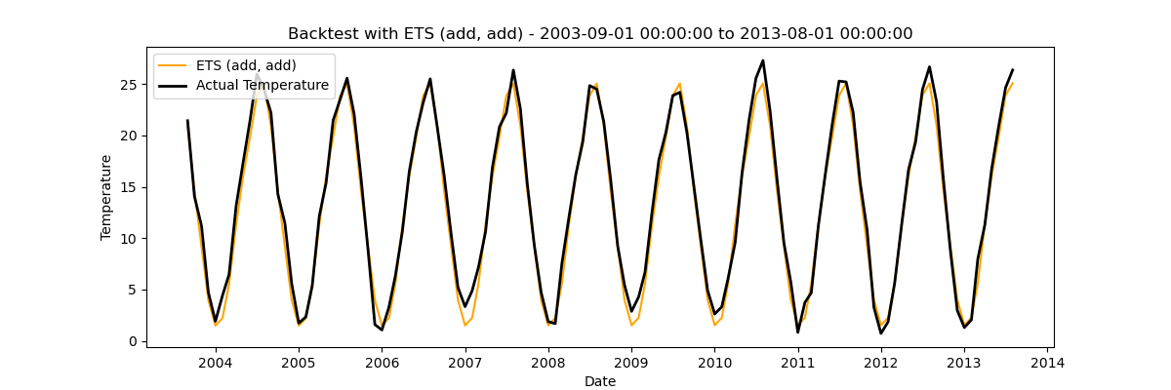
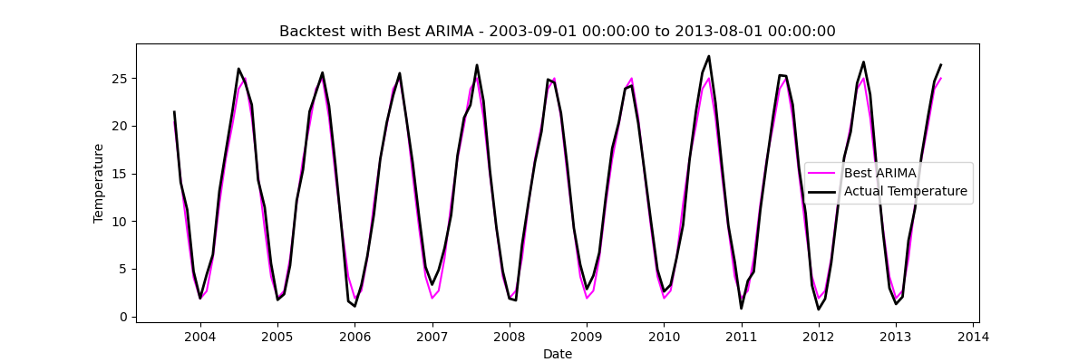
Backtesting Example - 10 Years, Tokyo
Exponential Smoothing
ARIMA
Notes:
Our temperature forecasts have been incredibly accurate for longer-term period as well. Notice the two charts for a 10-year period. Again, our forecasts are very close to the Actuals.
This gives us high confidence in our Climate Compass solution.

Slide 14
Monetization Strategy

Slide 15
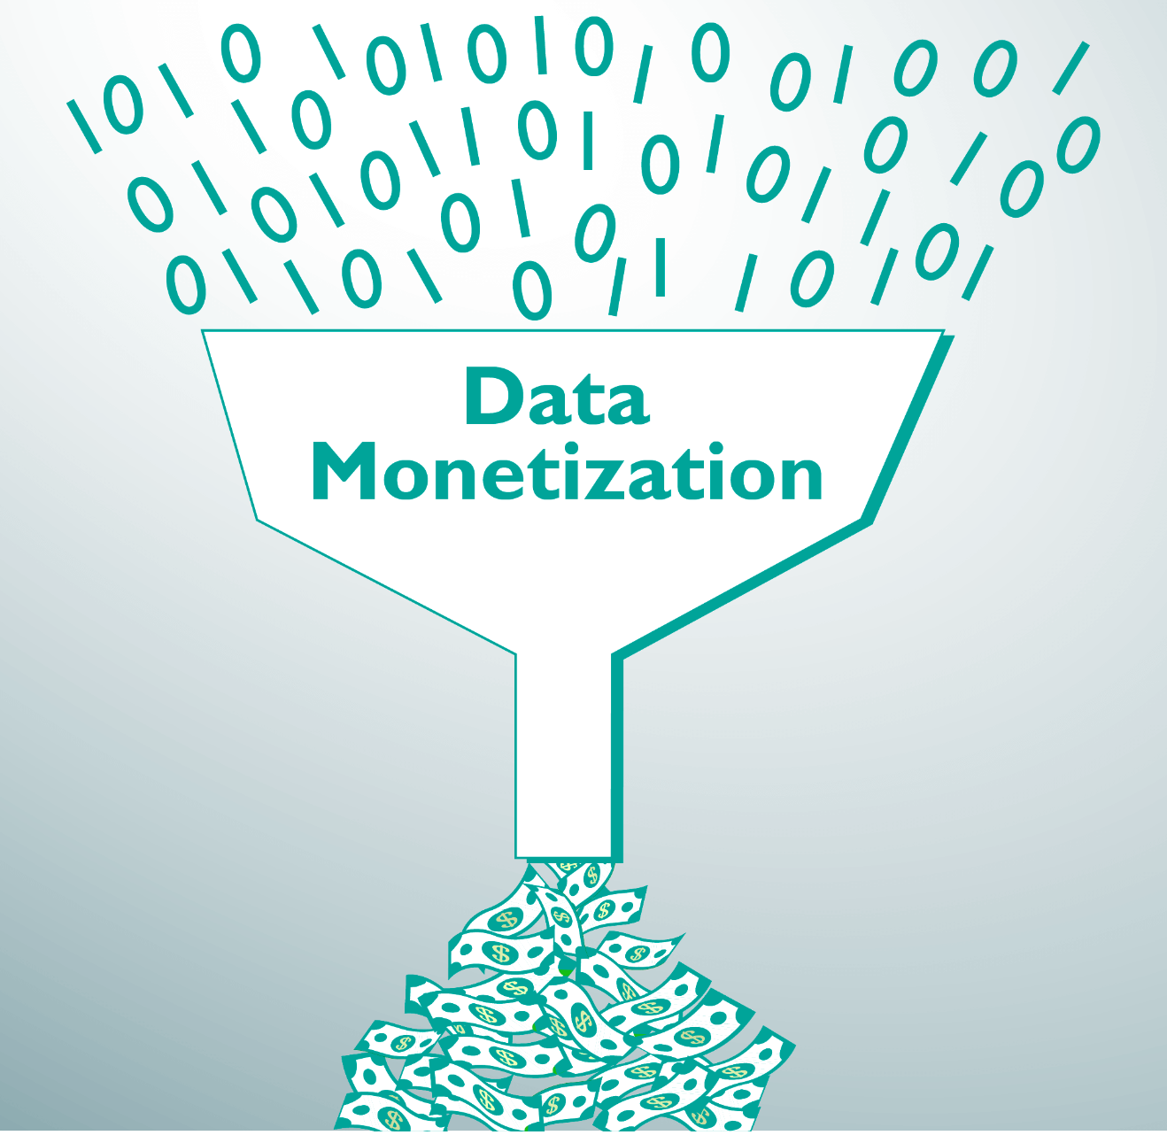
Monetization
Individual users pay per report
$10 per city report
Organizations use a subscription model
$100 annually, or $10 monthly per user
Possible free version with advertisements
TBD
Notes:
Our monetization strategy includes a per city report for individuals. And per-user subscription based service for governments and businesses.
We are also keeping an option open to online advertising-based revenue model.

Slide 16
Short-Term and Long-Term Roadmap - Features
Minimal Viable Product (MVP)
Support approx. 50 cities
Online browser support
Temperature forecast support
Financial Burn Rate: 18% of 1M
Launch ClimateCompass v2.0
Include more cities (U.S., global)
Automate model testing and deployment with GitHub Action
Cumm. Financial Burn of 78% of 1M
2024 Q4
2025 Q4
2024 Q2
2025 Q2
Launch ClimateCompass v1.0
iOS and Android platforms
Set up large scale infrastructure for things like compliance and security
Cumm. Financial Burn of 42% of 1M
Launch ClimateCompass v3.0
Forecast other metrics: precipitation, rising sea levels, etc.
Cumm. Financial Burn of 120% of 1M,
Milestone - Break Even.
Notes:
Our roadmap includes the following:
MVP Launch in EOQ2 2024. MVP will includes support for temperate forecast in approx. 50 cities. It will support common browsers and mobile views on IOS and Android devices.
V1 Launch in EOQ4 2024, which includes features in native mobile apps on iOS and Android platforms. And we will solidify our infrastructure more for scale.
V2 Launch in EOQ2 2025, which extends scope to more US and global cities. We will also build automation of data, testing, and deployment pipelines.
V3 Launch in EOQ4 2025, which extends forecasting features from temperature to other weather characteristics such as precipitation, humidity, rising sea levels, etc.
Our ask from the shark tank team is funding for 1M USD. If granted, a glimpse of the planned cumulative financial burn is provided on the slide. It supports our continued planned growth and keeps us afloat until our planned break even milestone in Q4 2025.

Slide 17
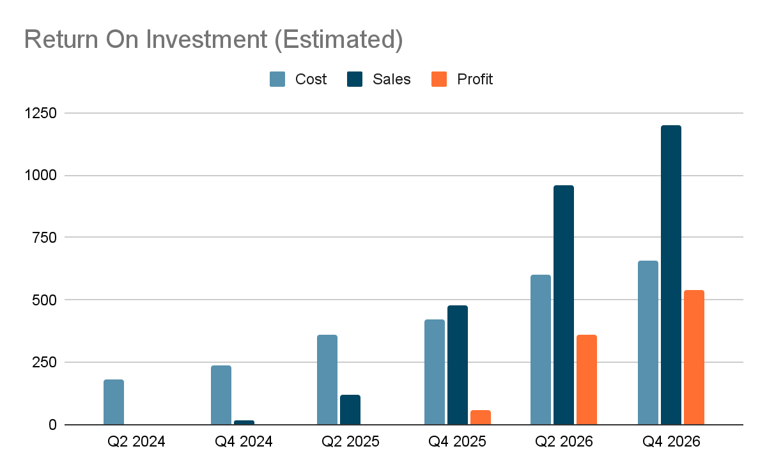
Estimated ROI
Our Ask
1M USD
Key Milestone
Breakeven: Q4 2025
Highlights:
Tight Control on Costs
Urgent Need
Global Market
High Margins
Sticky Business
Notes:
Here is a more detailed view of our projected Costs, Sales, and Profit
Our key milestone of BreakEven is Q4 2025, after which, we are not only taking care of our operating expenses but generating recurring profits
Our key highlights are
Tightly controlled costs - more details in an Appendix slide
There is an urgent in the market need for our services
The same solution will work for global cities
High margins business model
Sticky business with recurring revenue due to subscription-based model.

Slide 18
APPENDIX

Slide 19
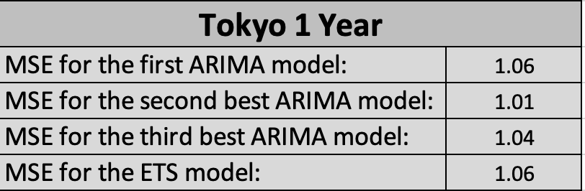
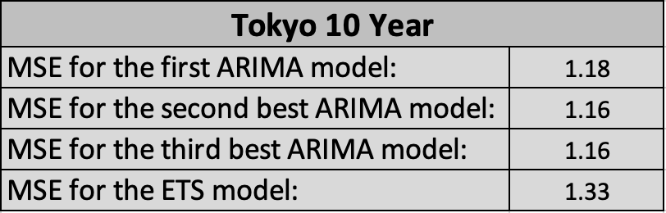
Mean Squared Error for Tokyo Backtests

Slide 20
Key Company Positions
Title | Name | Monthly Salary (first year) | Company Ownership
Program Manager | Nitin Chandola | $5,000 | 20%
Data Scientist | Chad Merrill | $5,000 | 20%
Data Engineer | Nithin Manjooran | $5,000 | 20%
UI Engineer | Praneet Yavagal | $5,000 | 20%
Product Manager | Sahil Somani | $5,000 | 20%
HR & Legal Services - Outsourced | Outsourced | $5,000 | N/A

Slide 21
High-Level Financials (Quarterly Estimation)
Item | Q2 2024 | Q4 2024 | Q2 2025 | Q4 2025 | Q2 2026 | Q4 2026
Salary | $30k | $30k | $50k | $75k | $175k | $200k
Cloud Infrastructure | $70k | $100k | $150k | $175k | $200k | $225k
Other Operating Expenses (Office space, equipment, utilities, marketing, etc.) | $50k | $70k | $100k | $100k | $125k | $125k
Sub-Total | $150k | $200k | $300k | $350k | $500k | $550k
Contingency (20%) | $30k | $40k | $60k | $70k | $100k | $110k
Total | $180k | $240k | $360k | $420k | $600k | $660k
Cumulative Burn | $180k | $420k | $780k | $1,200k | $1,800k | $2,460k

Slide 22
Estimated Revenue Generation (Quarterly)
User Group | Q2 2024 | Q4 2024 | Q2 2025 | Q4 2025 | Q2 2026 | Q4 2026
Individual users | Product Not Launched Yet | $10k | $50k | $200k | $400k | $500k
Government user | – same – | $5k | $20k | $80k | $160k | $200k
Business users | – same – | $5k | $50k | $200k | $400k | $500k
Total | $0 | $20k | $120k | $480k | $960k | $1,200k

Slide 23
Thank You!
Have Questions?
Send us an email at investments@climatecompass.com

